Slide 1


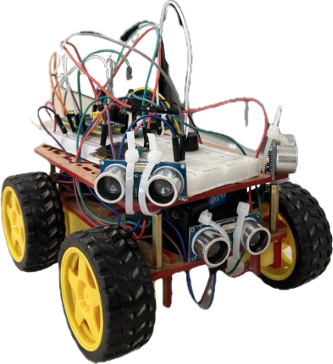


Wall_E
Obstacle Avoider Wheeled Robot
By:
Fatma Alagroudy 21-101154
Kerollos Ehab 21-101137
Manuel Ashraf 21-101148
Yara Abbas 21-101151
Youssef Nagah 21-101139

Slide 2

Table of Contents
01
Who is Wall-E ?
02
How we started
03
Main Components
04
Algorithm and Logic
05
Challenges
06
Demo

Slide 3
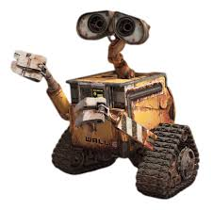
Who is Wall-E?

Slide 4

HOW WE STARTED

Slide 5
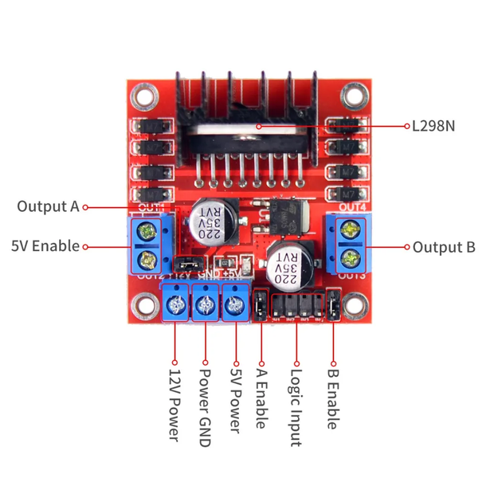
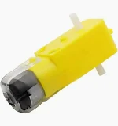
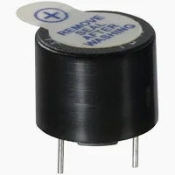
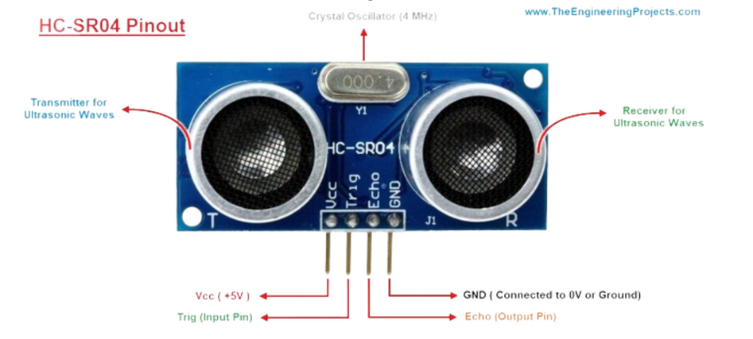
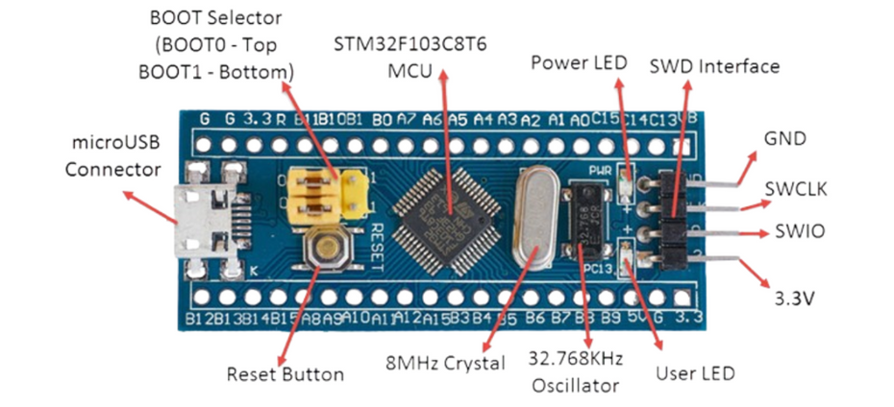
Main Components
4 Yellow DC Motor
Buzzer
Motor Driver
3 Ultrasonic sensors
Blue Pill Microcontroller

Slide 6
Start
Sensor reads the front distance
Front distance < 50cm?
Move forward
No
Algorithm
and
Logic
Yes
Read right and left distances
Yes
Turn right
Yes
Right distance > left?
No
Turn left
Sensor reads the front distance

Slide 7
Challenges
ResOURCES AND MATERIALS
WIRING AND CONNECTIONS
REACTION TIME OF THE ROBOT

Slide 8
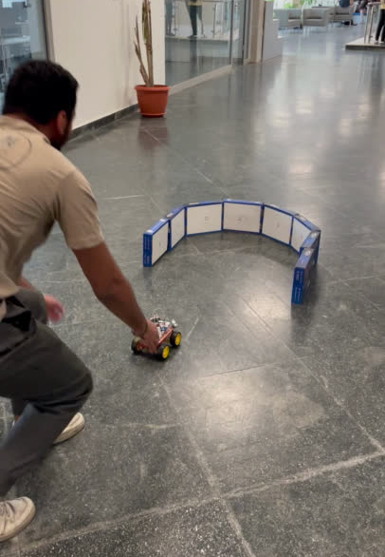
Demo

Slide 9
References
“HC SR04 Datasheet and Pinout – Ultrasonic Sensor Noncontact Range Detection.” NetSonic, 25 June 2021, https://netsonic.fi/en/hc-sr04-datasheet-and-pinout-ultrasonic-sensor-noncontact-range-detection/
Pelayo, Roland. “Getting Started with Blue Pill and STM32Cube.” Microcontroller Tutorials, 2 October 2020, https://www.teachmemicro.com/getting-started-blue-pill-stm32cube/
“L298N - Motor.| Micropeta ” Www.micropeta.com, www.micropeta.com/video20
MicroPeta by Nizar Mohideen. “42. STM32CubeIDE Ultrasonic Distance Sensor. HC-SR04 with STM32F103C8T6.” YouTube, 23 Aug. 2021, www.youtube.com/watch?v=oD0mc6FXQ0s&t=31s
Goswami, Shankha Shubhra, and Sushil Kumar Sahoo. “Design of a Robotic Vehicle to Avoid Obstacle Using Arduino Microcontroller and Ultrasonic Sensor.” Advances in transdisciplinary engineering, 2023.

Slide 10
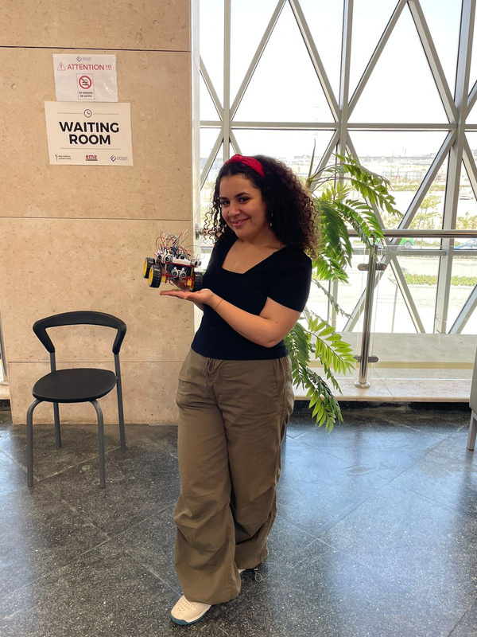
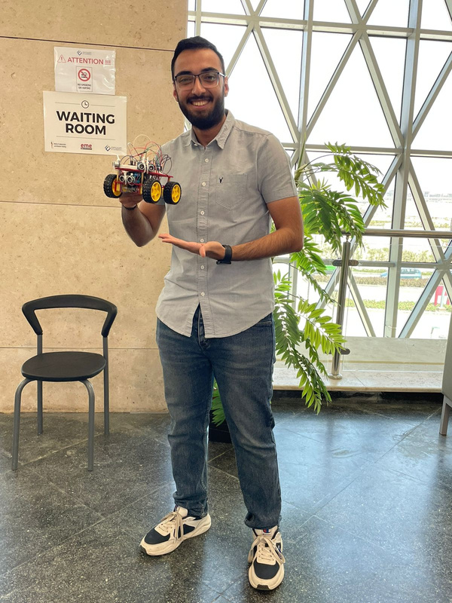
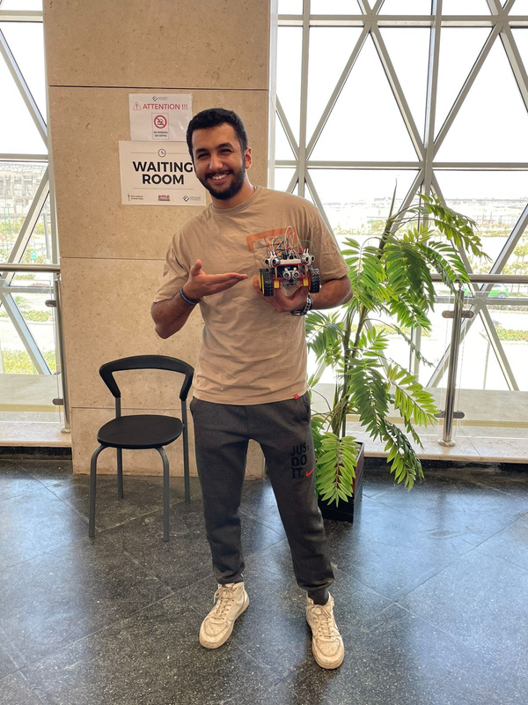
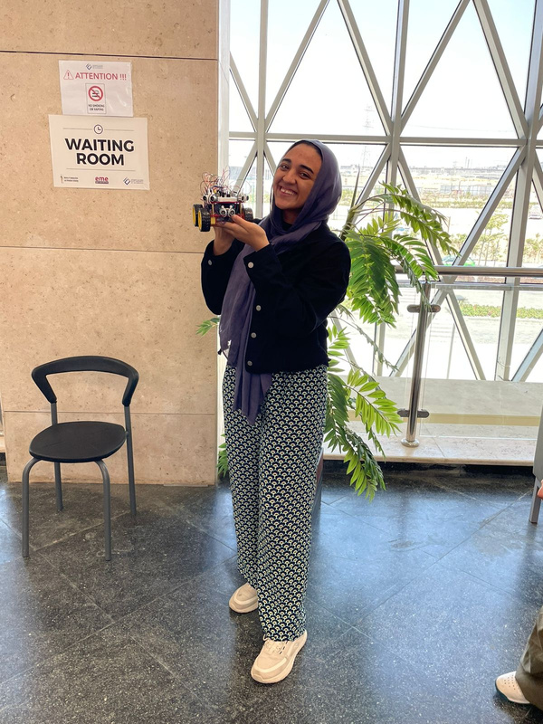
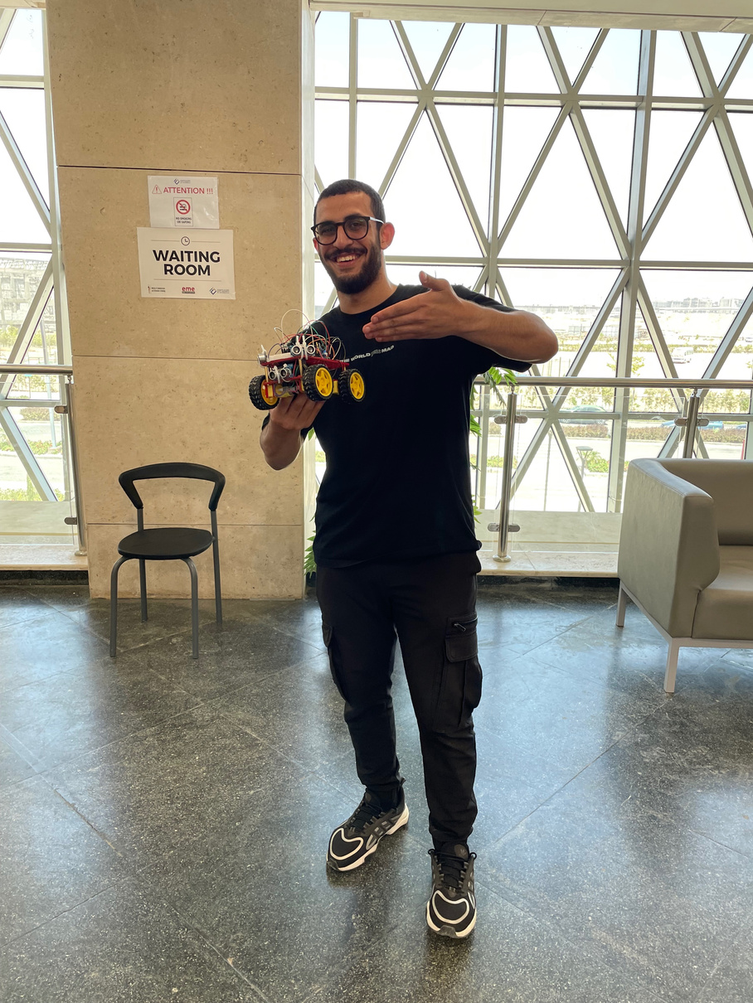
Our Team
Fatma ALagroudy
Kerollos Ehab
Manuel Ashraf
Yara Abbas
Youssef Haider

Slide 11

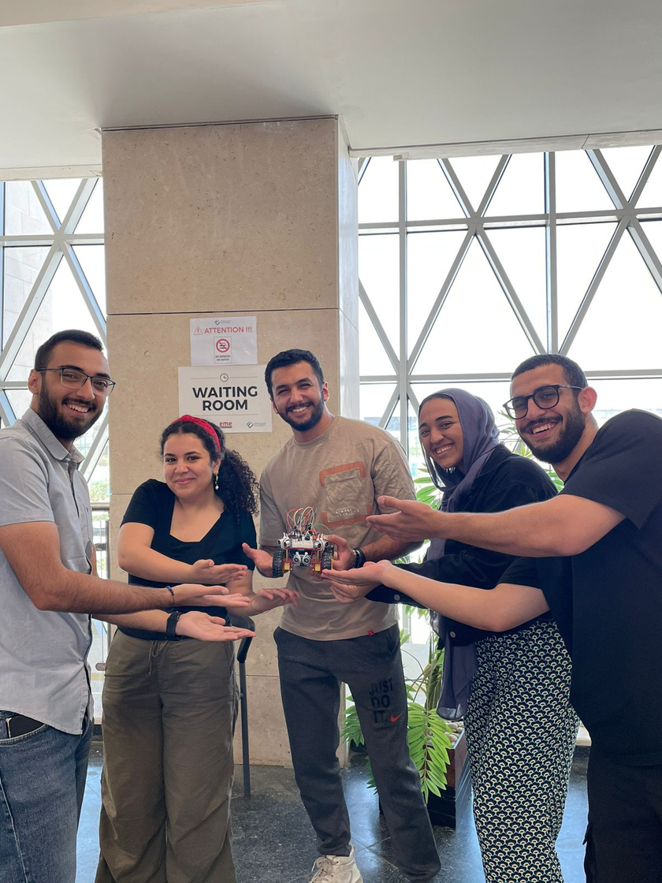
Wall-E
THANK YOU!

